Slide 1























Slide 2

































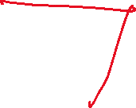





Slide 3

































Slide 4




















Slide 5

















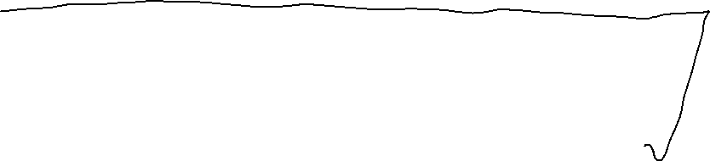





















Slide 6







































Slide 7



































Slide 8

































Slide 9






























Slide 10










































Slide 11
































Slide 12
day | outlook | temp | humidity | wind | play
D1 | Sunny | Hot | High | Weak | No
D2 | Sunny | Hot | High | Strong | No
D3 | Overcast | Hot | High | Weak | Yes
D4 | Rain | Mild | High | Weak | Yes
D5 | Rain | Cool | Normal | Weak | Yes
D6 | Rain | Cool | Normal | Strong | No
D7 | Overcast | Cool | Normal | Strong | Yes
D8 | Sunny | Mild | High | Weak | No
D9 | Sunny | Cool | Normal | Weak | Yes
D10 | Rain | Mild | Normal | Weak | Yes
D11 | Sunny | Mild | Normal | Strong | Yes
D12 | Overcast | Mild | High | Strong | Yes
D13 | Overcast | Hot | Normal | Weak | Yes
D14 | Rain | Mild | High | Strong | No

Slide 13



























Slide 14




























Slide 15









































Slide 16





























Slide 17





























Slide 18



































Slide 19






































Slide 20






























Slide 21


































Slide 22



























Slide 23











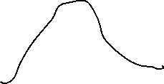







Slide 24












